Slide 1
March 14th, 2019
illHUEminate
Proudly Presented by Phuoc Phan, Sarah Sakhi, Paul Xu and Holland Gronau
University of Toronto SCS Coding Boot Camp API Capstone Project

Slide 2
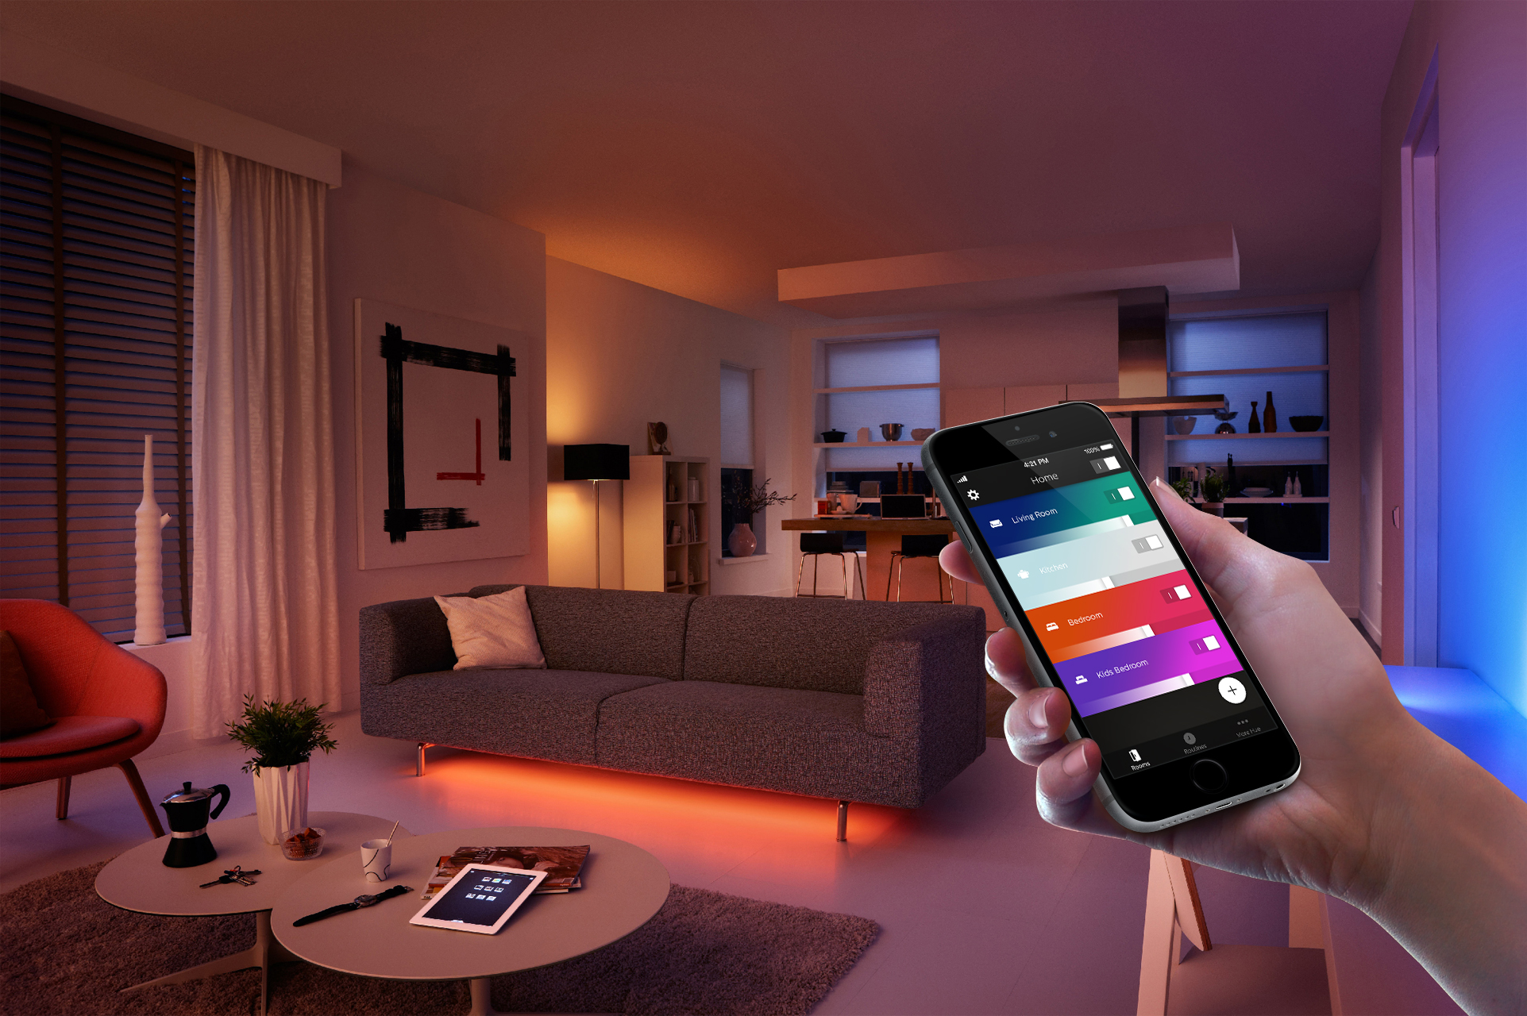

Agenda
Descriptions
Motivations
Technologies and Functionalities
Efforts and Contributions
Improvements

Slide 3
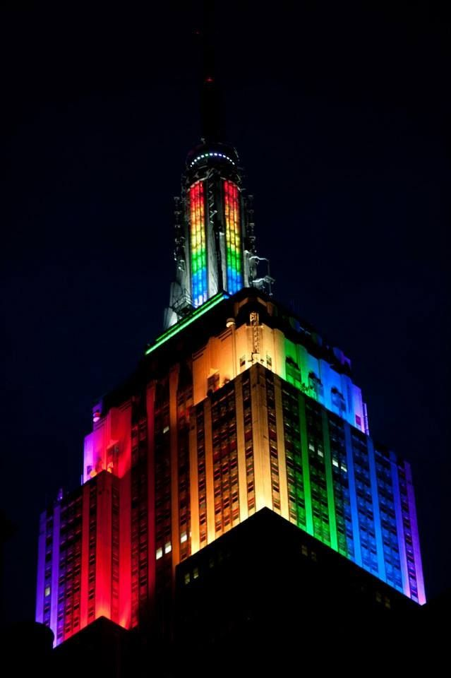
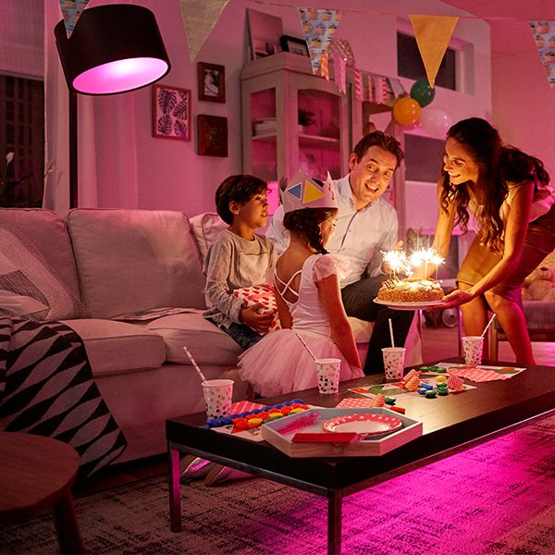
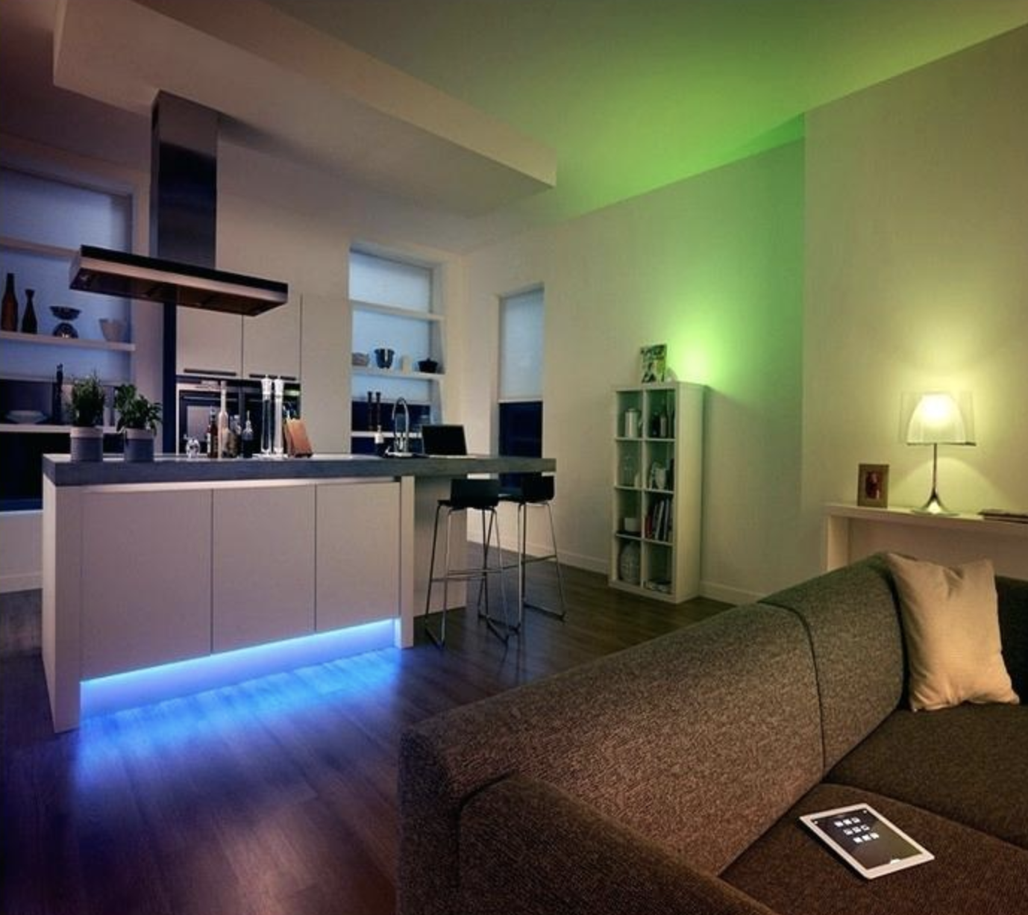
Descriptions
What is illHUEminate
Smart color assisting
Complex image background analyzing
Precise color matching
Who can be our target audience for illHUEminate
All Philip Hue users who:
Eager to have a flashy interior lighting
Enjoy a creative home party
Crave to get a vivid exterior color show

Slide 4
Motivations
Lamp is easy to visualize color change.
Color lovers. Color and Hue API are perfect!
Philip hue with bridge is a technology trend.

Slide 5
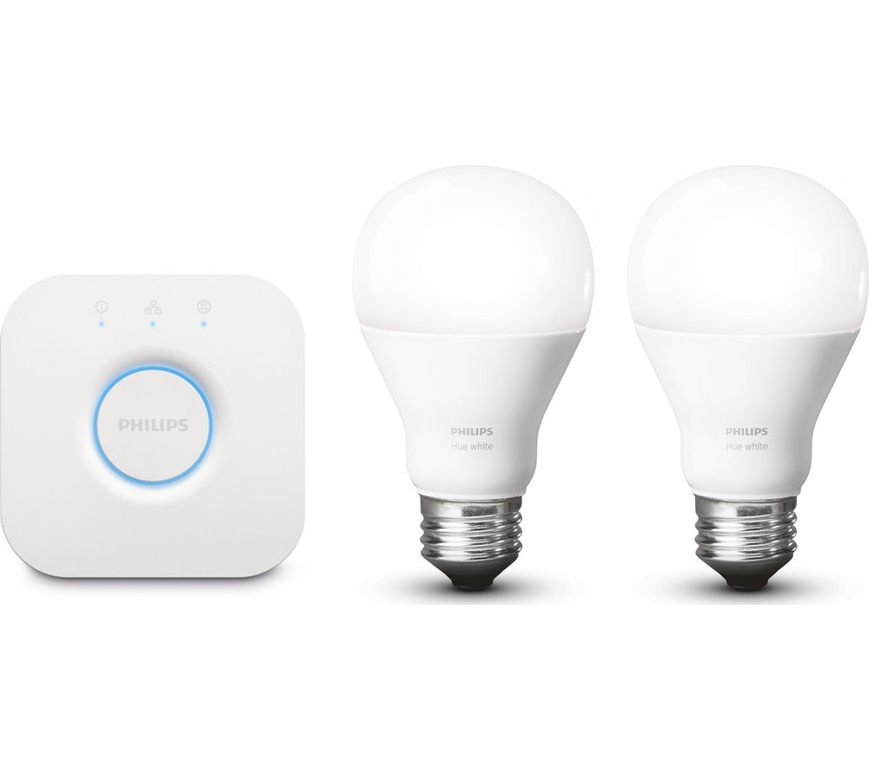
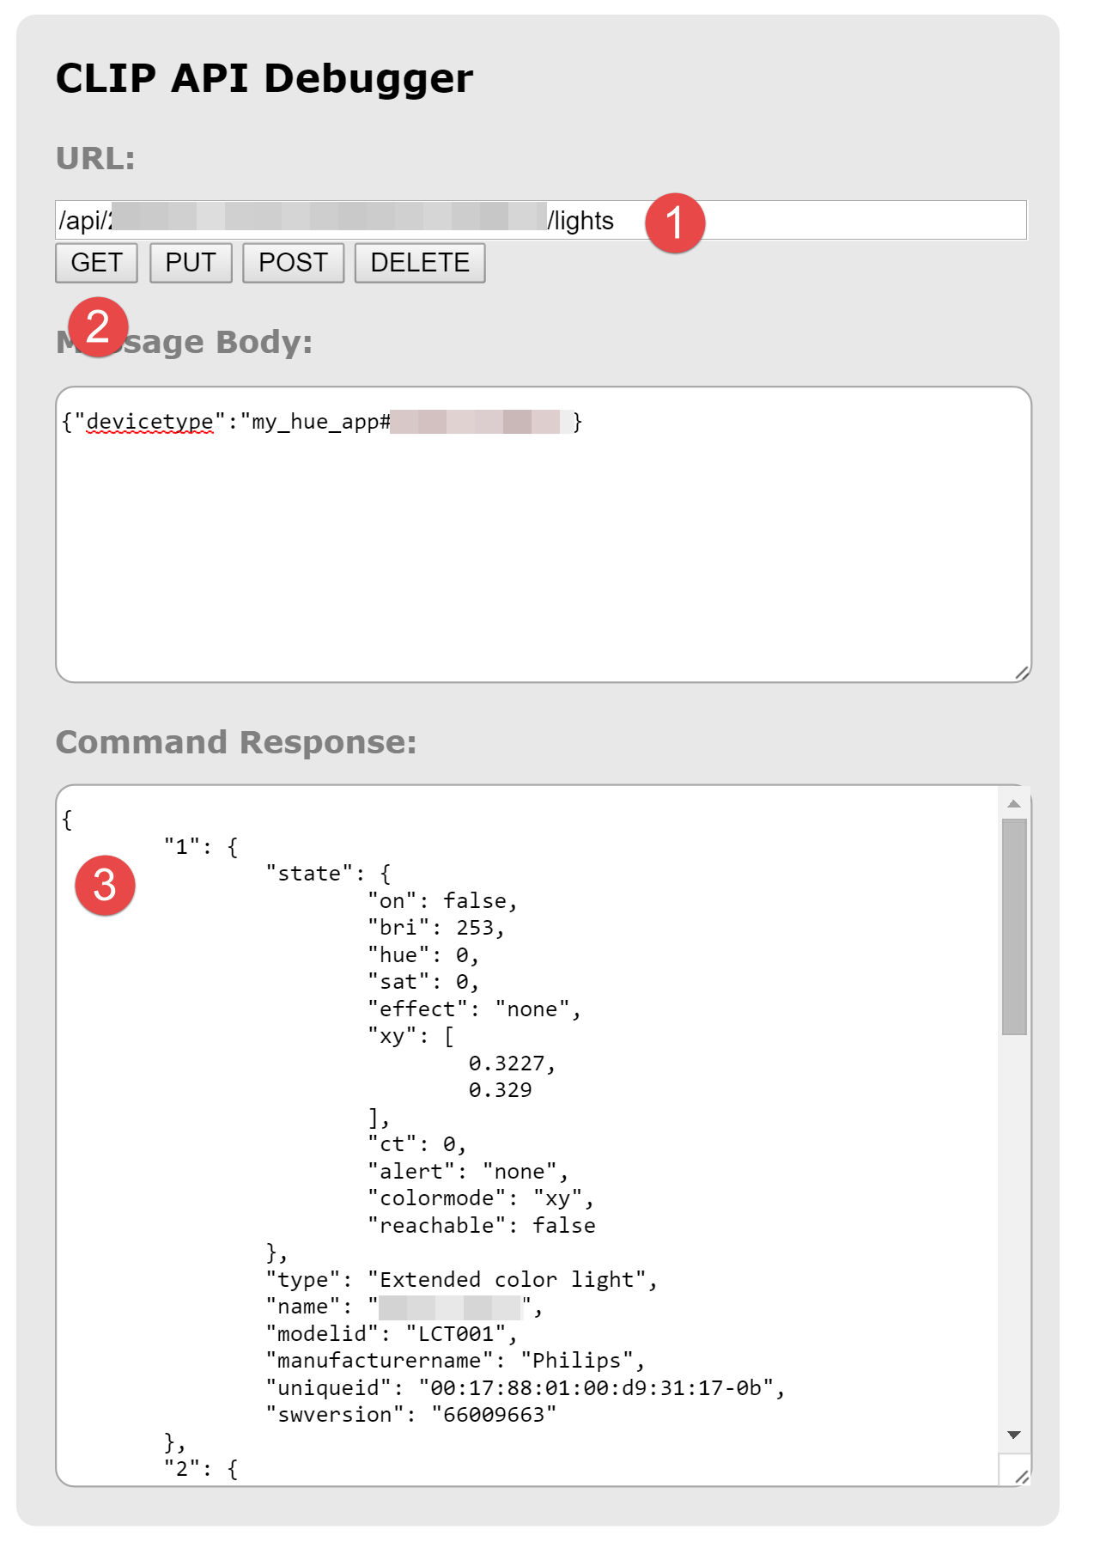
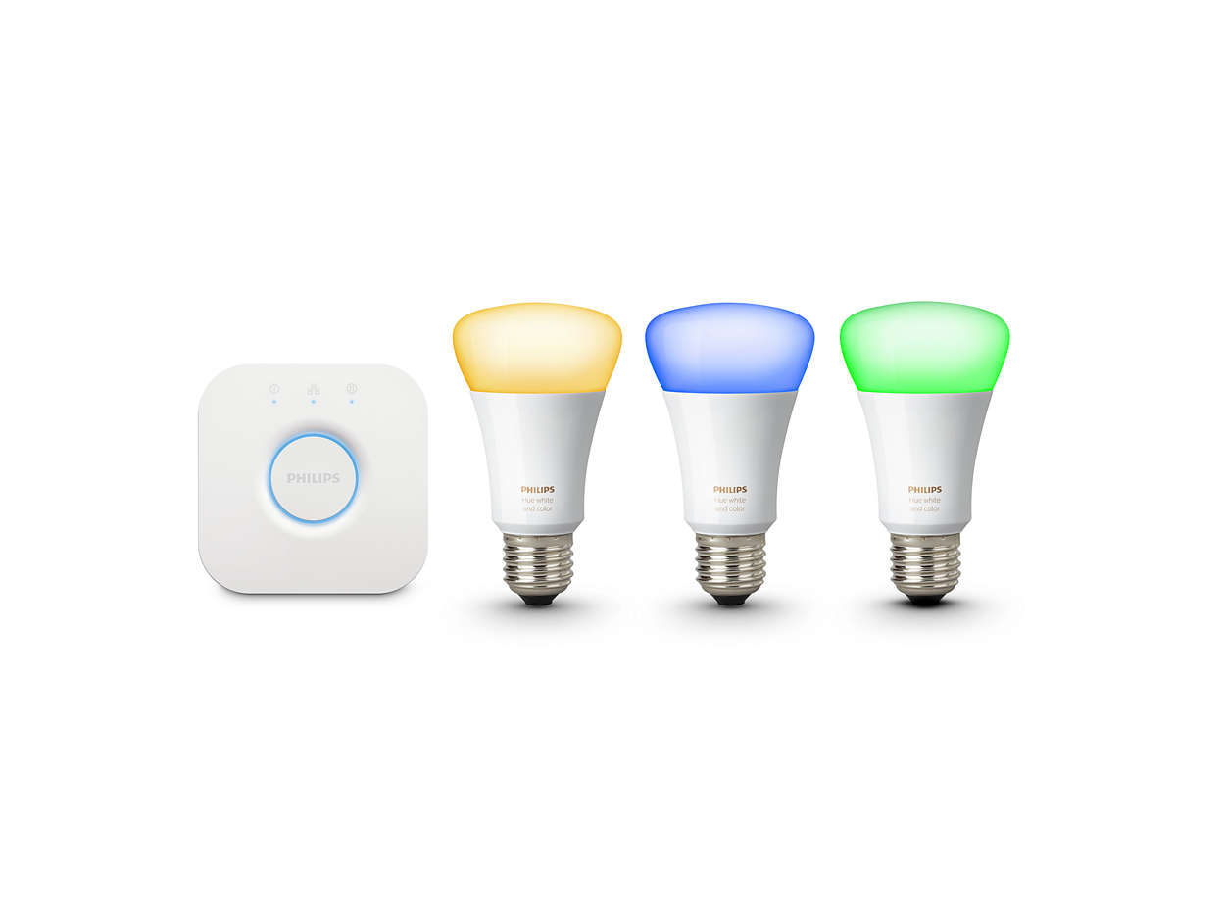
Process
Developers’ Point of View
Users’ Point of View (by steps)
Project Managers’ Point of View

Slide 6
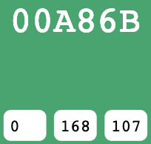
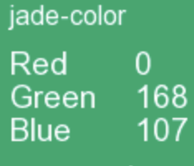
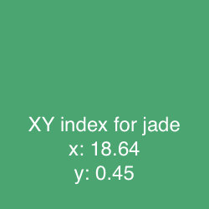
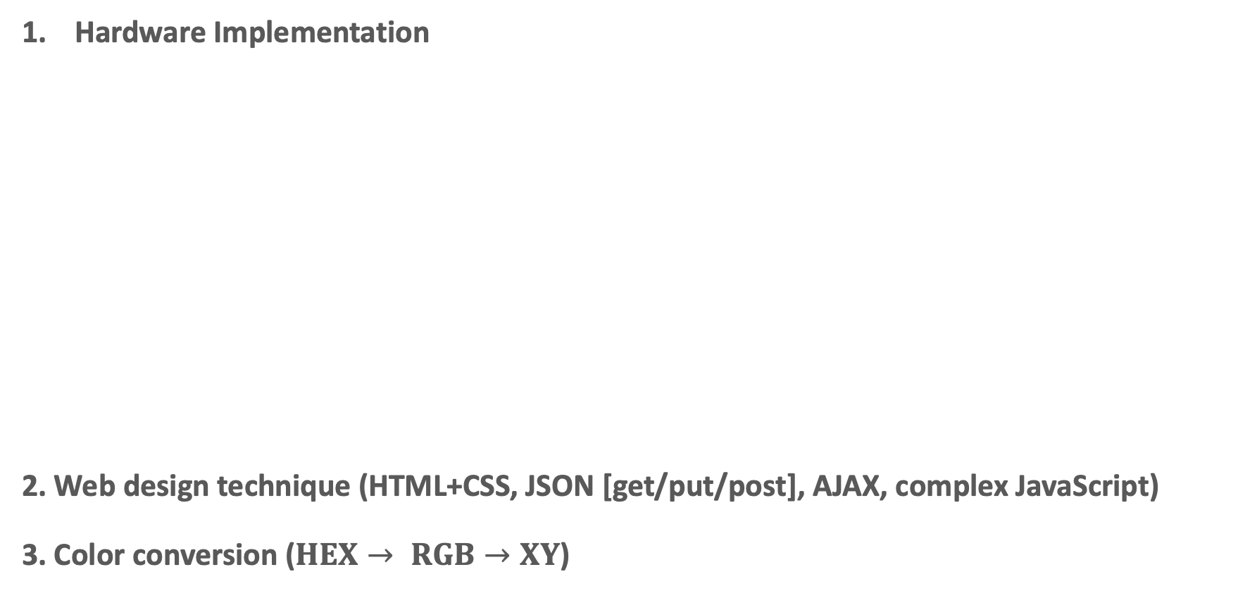
Technologies and Functionalities
Hardware Implementation
2. Web design technique (HTML+CSS, JSON [get/put/post], AJAX, complex JavaScript)
3. Color conversion ($HEX→ RGB→XY$)

Slide 7





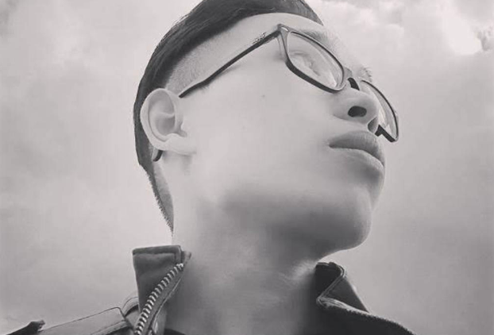

Efforts and Contributions
HTML, Lead CSS, GIF creator, Demo recorder
Updating work done on Trello
Hardware supplier, API account set up
Associate with HTML and JavaScript (focus on color conversion, URL input button)
Testing Hue API Debugger; Trello Creator
Lead JavaScript (color tag button, URL click button, color conversion, image background color)
Trello update, help set up HUE; Firebase to select URL image
Hue API Debugger Test, Outsource color conversion
GitHub Repo Creator and Monitor, update README
Manage project presentation

Slide 8
Wonder illHUEminate looks like?

Slide 9
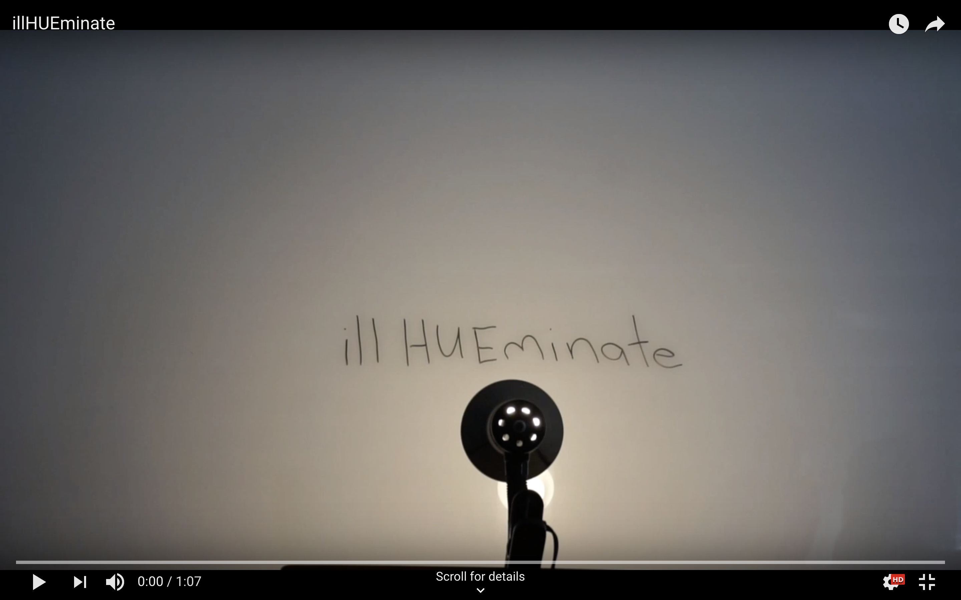

See our demo

Slide 10
Improvements
User login page
Music API Involved
Multi-hue Lighting Control
Philip Strip Lighting Control

Slide 11
Thank you all for listening!

